Slide 1
Sensing and Perception
Fall 2018
Dr. Brian Huff, IMSE Dept.
Dr. Atilla Dogan, MAE Dept.
Dr. Manfred Huber, CSE Dept.
Presentation Derived from material produced for “Introduction to Robotics and Unmanned Vehicles”, A Seminar Produced by TMAC for Lockheed Missiles & Fire Control June 16th, 2009 created by Dr. Raul Fernandez and Dr. Brian Huff

Slide 2
What will we cover?
Introduction to Sensors and Perception
Internal / Vehicle-Centric Sensing
External / Situational Sensing
Mission / Task Specific Sensing

Slide 3
Why Talk About Sensors?
To understand the critical roll that sensing and perception has in the creation of unmanned and autonomous systems.
To Introduce the key technologies that allow UxVs to be aware of their status and surroundings.
To understand the difference and significance between vehicle-centric internal sensors, external and state vehicle sensors, and mission-centric sensors .

Slide 4
Introduction to Sensors
A sensor is a device that converts a physical stimulus (temp., pressure, force, etc.) into a compatible form (voltage, current, digital stream) that can be interpreted by a control system for the purpose of measuring the stimulus.
There is a very wide range of sensors available.
Sensors, Processors/Controllers, and Software are all required to perceive operating conditions in todays digital systems.
Compatibility of the sensors, processors, code, and the execution/application environment must be considered.

Slide 5
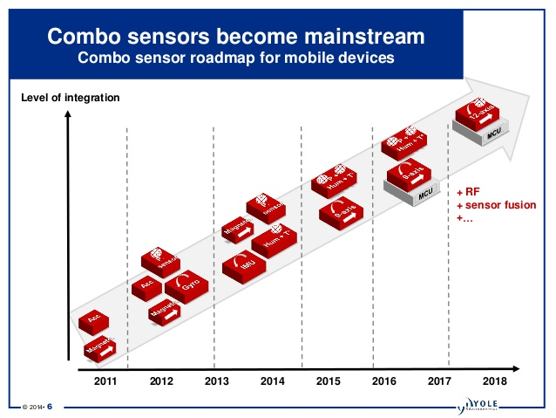
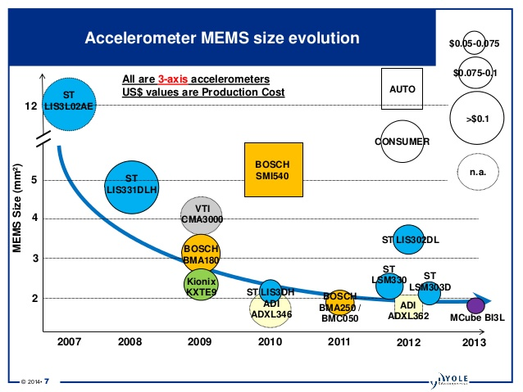
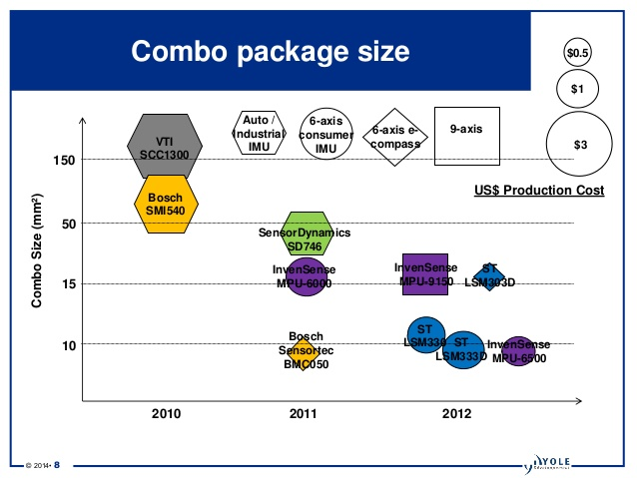
Trends in Sensor Development
Better, Smaller, Cheaper
Inertial MEMS Manufacturing Report 2014 by Yole Development

Slide 6
Desirable Sensor Features
Feature | Comment
High Accuracy | Measurements have small systematic errors about the true value.
High Precision | Random variability of the measurement is low.
Wide Operating Range | Provides valid measurements over a large proportion of the possible feature values.
High Speed of Response | Minimizes the time required to take the measurement.
Ease of Calibration | The calibration is simple and fast.
Minimum Drift | The sensor does not report different values for the same measured input as a function of time.
High Reliability | The sensor does not frequently fail and can function in the required operational environment
Low Cost | The purchase and installation costs are appropriate for the application
Compatible with the System Architecture | Sensor is compatible with the system processor, software, and application requirements.
Modified from Automation, Production Systems, and Computer-Integrated Manufacturing, 3rd Edition, Mikell P. Grover

Slide 7
Sensor Integration
Select the sensor / processor combination that best matches the application environment.
The structure and performance of the software used to read the sensor can have a big impact on system performance.
Software may be written to perform very simple or complex tasks
Routine platform operation
Diagnostics (why has the system failed)
Prognostics (when will the system fail next)
Software development costs generally far exceed the cost of the physical sensor.

Slide 8
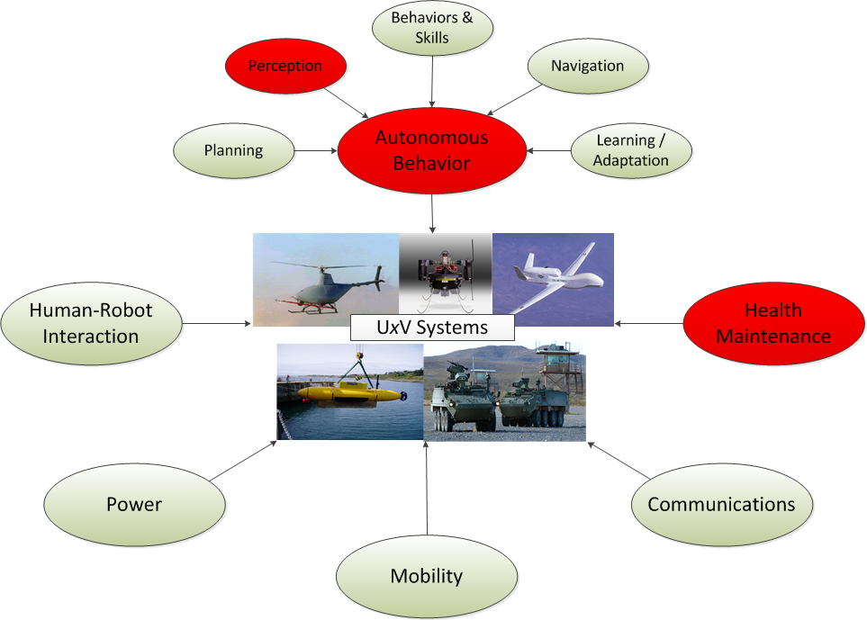
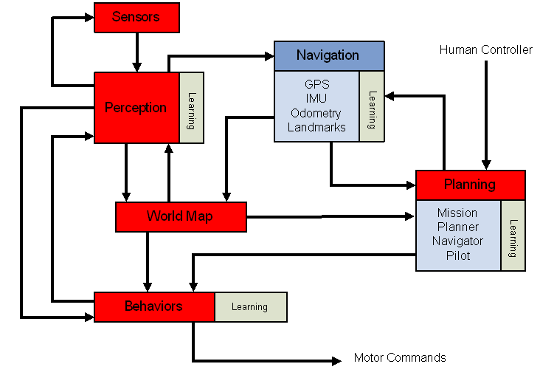
Internal / Vehicle-Centric Sensing

Slide 9
Internal / Vehicle-Centric Sensing
Supports UxV Health Maintenance Functions
Platform operation monitoring
Diagnostics (why has the system failed)
Prognostics (when will the system fail next)
Enable the operation of basic vehicle functions, independent of mission:
A temperature sensor is used to regulate the amount of cooling needed for an engine.
A voltage sensor is used to monitor the amount of charge remaining on a battery.

Slide 10
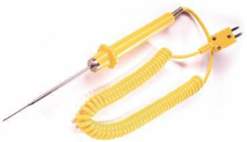
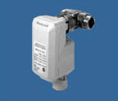
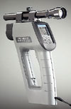
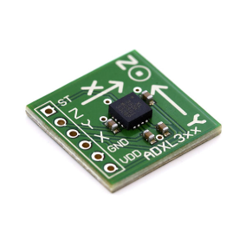
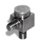
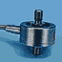
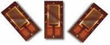
Internal / Vehicle-Centric Sensing
Temperature Measurement
Thermocouple
Resistance Temperature Detectors
Infrared
Vibration Measurement
Displacement-based
Velocity-based
Accelerometers.
Force Measurement
Load Cell.
Strain gauge

Slide 11
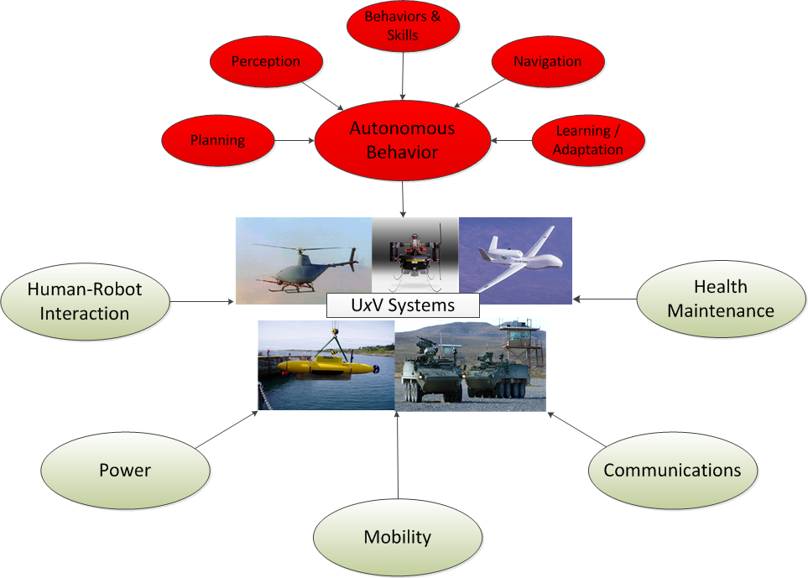
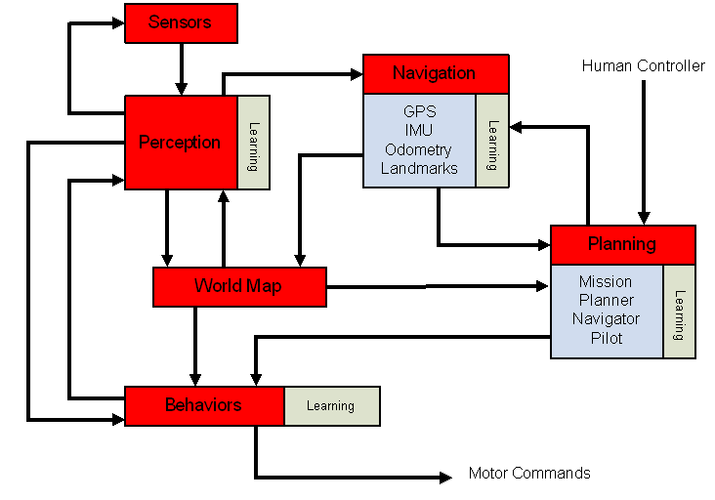
External / Situational Sensing

Slide 12
External / Situational Sensing
An unmanned system working in an unstructured environment cannot function without the ability to sense and react to its environment.
Sensors enable the UxV to collect data about its environment.
This raw sensory data is then processed by the vehicle’s control system to generate information that can be used to influence the UxV’s behavior.

Slide 13
External / Situational Sensing
Classes of External Vehicle Sensors:
Vehicle State Sensors
Obstacle Detection Sensors

Slide 14
Vehicle State Sensors
Vehicle state refers to the position and orientation of the vehicle with respect to one or more relative or absolute reference frames.
For this discussion, we will also include devices and methods used to determine the vehicle’s velocity and acceleration as vehicle state sensors.

Slide 15
Vehicle State Sensors
Types of vehicle state sensors:
Global Positioning System (GPS) receivers
Digital Compasses
Inclinometers (tilt sensors)
Inertial Measurement Units (IMU)
Encoders

Slide 16
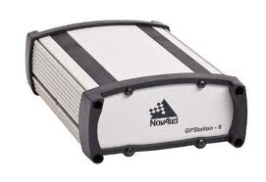
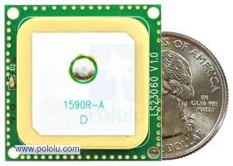
Global Positioning System (GPS) Receivers
Used to determine a globally referenced location of the vehicle.
A GPS receiver must be locked on to the signal of at least three satellites to calculate a 2D position (latitude and longitude). With four or more satellites in view, the receiver can determine the user's 3D position (latitude, longitude and altitude). The GPS unit can calculate other information, such as speed, bearing, track, trip distance, distance to destination, sunrise and sunset time and more.
GPS receivers take precise time information transmitted from these satellites and perform triangulation calculations to determine the users position.

Slide 17
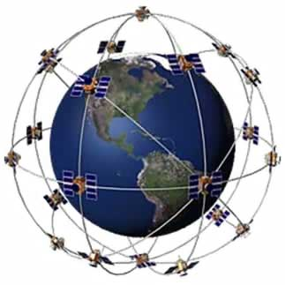
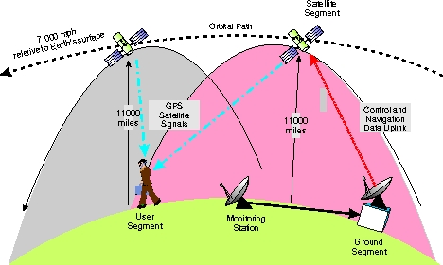
Global Positioning System (GPS)
Consists of a satellite-based navigation system made up of a network of 24 satellites.
GPS positioning information can be improved by obtaining additional information from fixed ground facilities. These enhancement strategies are referred to as Differential GPS and commonly uses the WAAS (Wide Area Augmentation System)
http://www.pocketgpsworld.com/howgpsworks.php
http://plane.ardupilot.com/wiki/
common-gps-how-it-works/

Slide 18
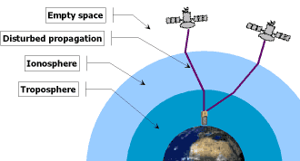
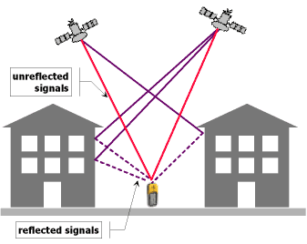
Limitations of GPS
Ionospheric perturbations and magnetic storms (solar activity) can cause signal delays. This can be partially compensated using SBAS and L1 / L2 decoding.
Multipathing is causing GPS position errors that are difficult to detect and compensate for. Multiple GNSS receivers are better suited to filter out multipathing thanks to a higher number of visible satellites at the same time.
http://plane.ardupilot.com/wiki/
common-gps-how-it-works/

Slide 19
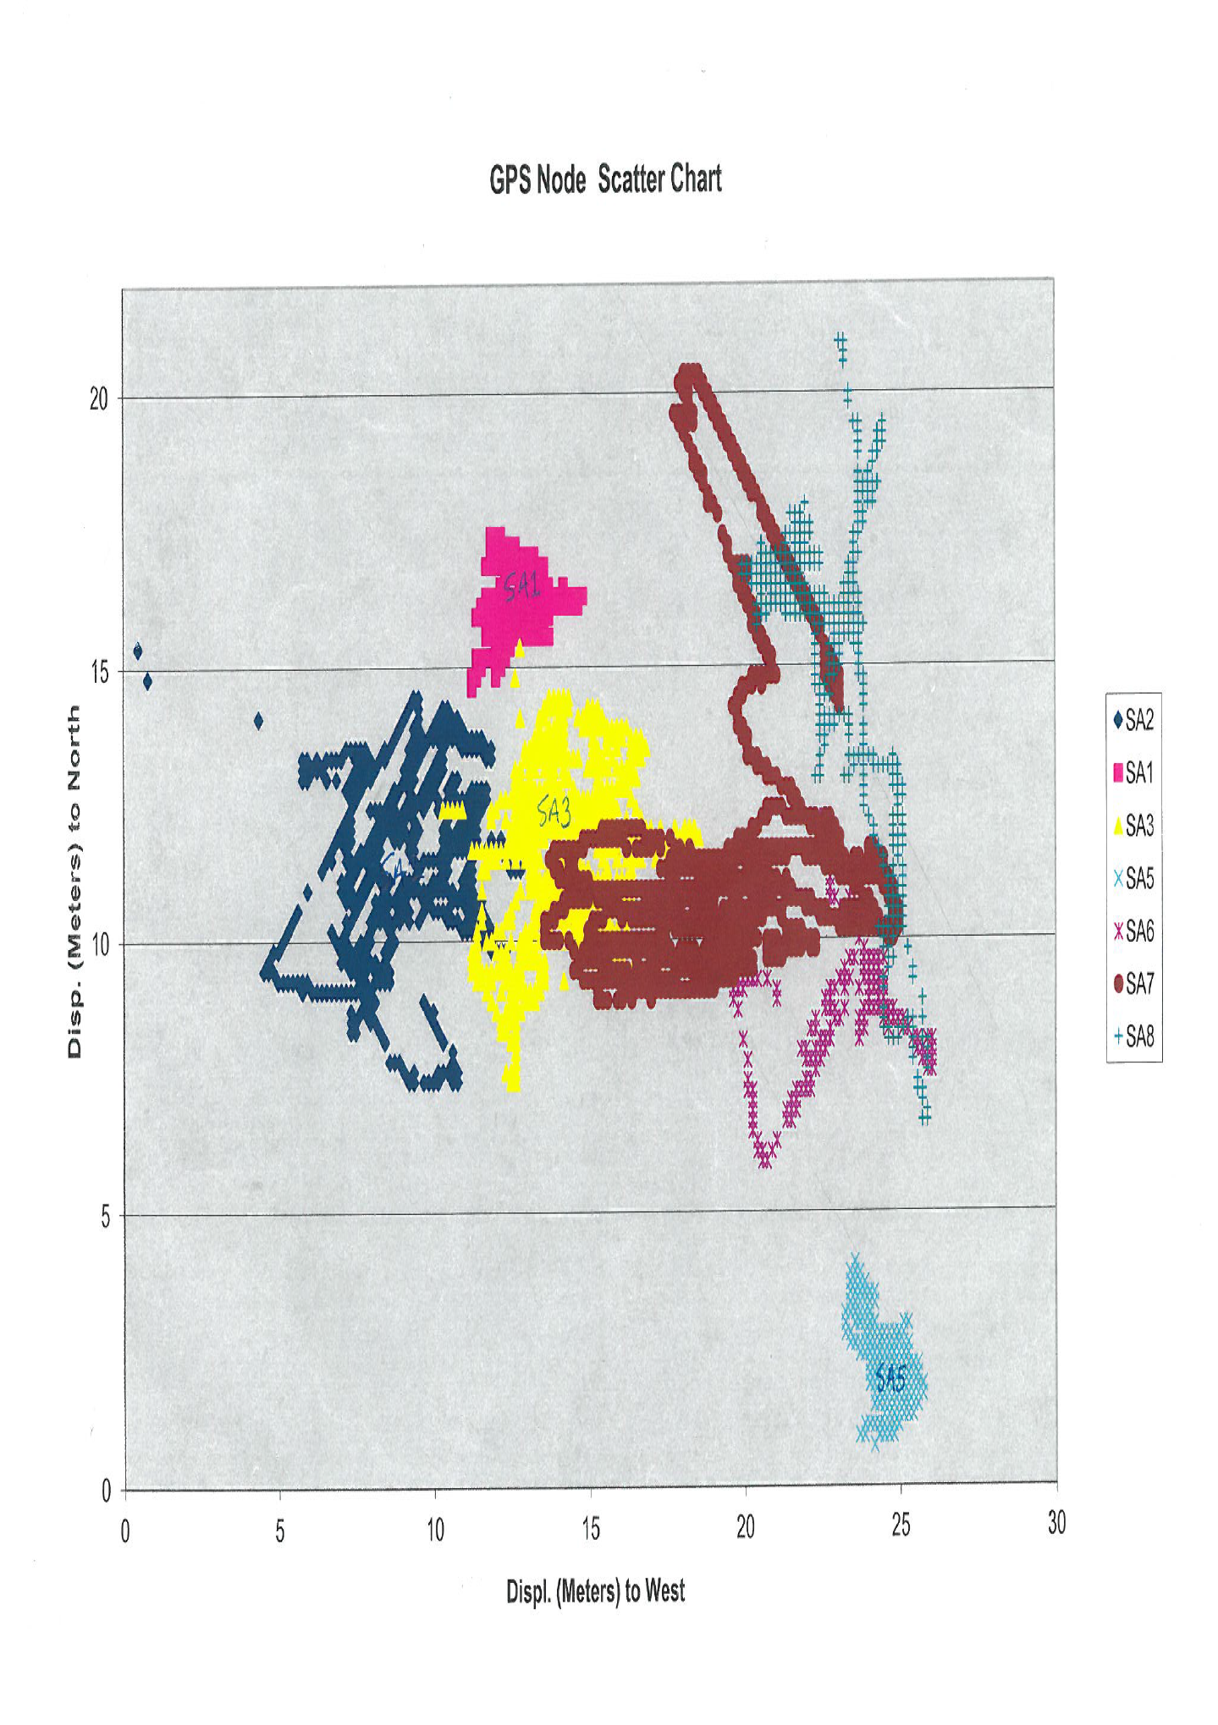
GPS Localization Experiment

Slide 20
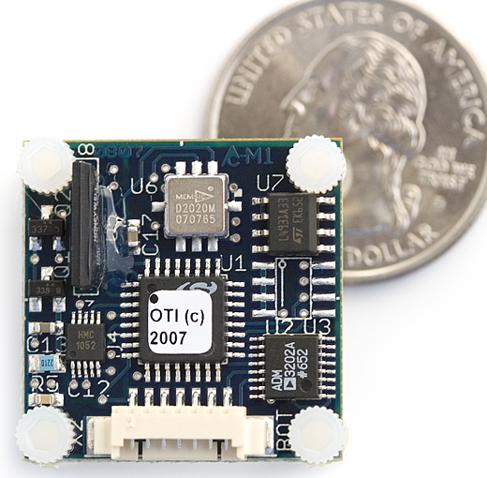
Digital Compass
Used to determine the orientation of the vehicle: Heading, Pitch, and Roll
Sense the difference in the earth’s magnetic field from a disturbance caused by external elements such as ferro-magnetic materials and magnetic fields generated by electrical systems.
Digital compasses generally consist of a 3-Axis Magneto Resistive Sensor, signal conditioning software and hardware, and tilt sensors or accelerometers to compensate for the relative orientation of the magnetic sensors.
An embedded microprocessor and associated software is used to transform these sensor inputs into the desired heading, pitch, and roll angles of the vehicle.
www.activatedspace.com/blog/?m=200707

Slide 21
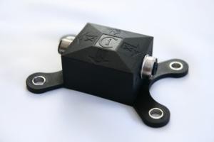
Inclinometers (tilt sensors)
Used for sensing movements and measuring relative orientation of an object with respect to a reference frame.
Common technologies include accelerometer, electrolytic, mercury, gas bubble liquid, and pendulum – based sensors.
www.sensorsportal.com/.../Inclinometer.jpg

Slide 22
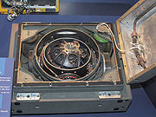
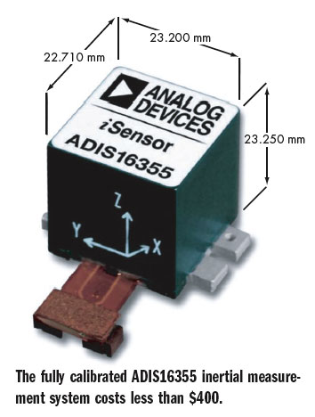
Inertial Measurement Units (IMU)
An IMU works by sensing the type, rate, and direction of motion.
This information provides the vehicle’s current rate of acceleration, as well as changes in rotational attributes such as yaw, pitch and roll.
System computers can use this data to calculate current vehicle speed and position, given a known initial speed and position.
Unlike GPS, IMUs do not need to communicate with any external systems to obtain their measurements. This enables navigation based on dead reckoning.
IMUs suffer from unbounded accumulated error. Other sensors can be used to compensate for IMU drift such as: GPS, gravity sensors, external velocity sensors, barometric sensors (altimeters), and digital compasses.
http://en.wikipedia.org/wiki/Inertial
_Measurement_Unit
electronicdesign.com/Files/
29/16141/Figure_01.jpg

Slide 23
Definitions
Navigation: Determination of a vehicle’s location, velocity and orientation
Inertial Navigation: Self-contained navigation technique that uses accelerometers and gyroscopes
Inertial Measurement Unit (IMU) is sensor that contains
three orthogonal rate-gyroscopes
measuring angular velocity
three orthogonal accelerometers
measuring linear (translational) acceleration

Slide 24
Inertial and Body-fixed Frames
IMU measures angular velocity and translational acceleration
of body-frame with respect to inertial frame
Body-fixed
Frame
IMU
Inertial Frame

Slide 25
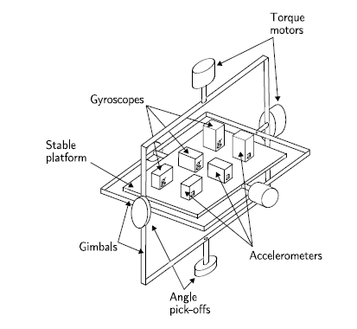
IMU Config Type - Stable Platform
Platform mounted through gimbals
=>
freedom of rotation around any axis
Platform is held aligned
with inertial frame
Gyroscopes detect platform rotation
Detected rotation fed back to torque motors
Torque motors rotate the gimbals to cancel out platform rotation
“angle pick-off” reads the angle between gimbals

Slide 26
IMU Config Type – Stable Platform
Gimbal angular
Pickoff signals
Orientation
Initial
Velocity
Initial
Position
Correct for
Gravity
Accelerometer
signals
Inertial
Acceleration
Inertial
Velocity
Position

Slide 27
IMU Config Type – Strapdown System
Inertial sensors mounted rigidly on the device
Measurements in the body frame
Reduced mechanical complexity
Physically smaller
Increased computational complexity
Orientation
Rate-gyroscope
signals
Initial
Velocity
Initial
Position
Project acceleration onto inertial frame
Correct for
Gravity
Accelerometer
signals
Inertial
Acceleration
Inertial
Velocity
Position

Slide 28

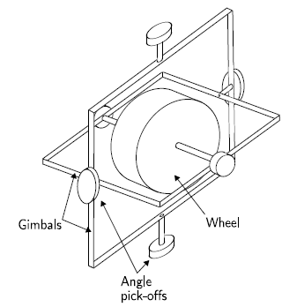
Gyroscope - Mechanical
Spinning wheel mounted on two gimbals which allow to rotate in all three axes
Conservation of angular momentum implies spinning wheel resists changes in orientation
Once spinning, a free gyro wheel stays oriented
in the same direction in space
despite changing position or orientation of its base
To measure the orientation of the device
the angles between adjacent gimbals are read
using angle pick-offs
=>
Mechanical gyroscope measures angle

Slide 29
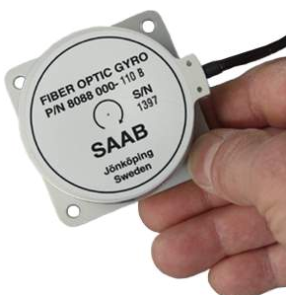
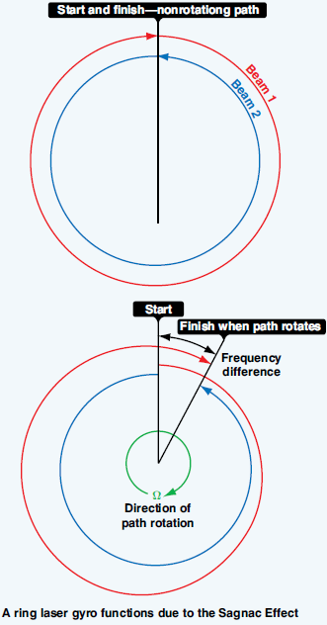
Gyroscope - Optical
Fiber Optic Gyroscope (FOG) or Ring Laser Gyroscope (RLG) uses the interference of light to measure angular velocity
A FOG consists of a large coil of optical fiber
RLG laser beams are directed around a closed path using mirrors
Two light beams fired in opposite directions
When sensor is rotating,
beam travelling in the direction of rotation takes longer
beam travelling against the rotation takes shorter time
Difference in frequency indicates angular speed

Slide 30
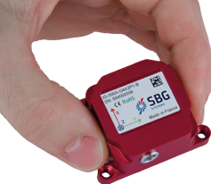
Gyroscope - MEMS
MEMS (Micro Electro Mechanical System) sensors are built using silicon micro-machining techniques
MEMS gyroscopes make use of “Coriolis effect” on vibrating mass
Single mass is vibrated along the drive axis
When gyroscope rotates
Coriolis Force induces vibration in the perpendicular direction
Angular velocity is computed from the secondary vibration

Slide 31
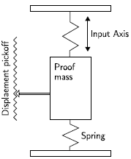
Accelerometer- Mechanical
Consists of a mass-spring system
Displacement of the mass measured using displacement pickoff
Displacement pickoff gives a signal proportional to Force through spring constant
Acceleration is calculated from the Force by Newton’s 2nd Law

Slide 32
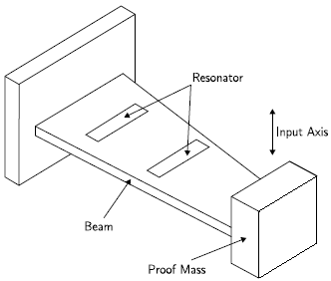
Accelerometer- Solid State
There are various types
Surface acoustic wave
Vibratory
Silicon and Quartz Devices
Surface Acoustic Wave (SAW)
Consists of cantilever beam resonating at a particular frequency
A mass attached to the free end
Acceleration changes the frequency
Acceleration is calculated from frequency measurement

Slide 33
Accelerometer- MEMS
Manufactured using MEMS techniques
MEMS accelerometers use the same principles as mechanical and solid state sensors
Two main classes
Mechanical
Measure displacement of a supported mass
Others
Measure frequency change of a vibrating element
Like SAW

Slide 34
MEMS Sensors compared to Others
Advantages
small size
low weight
rugged construction
low power consumption
short start-up time
inexpensive to produce (in high volume)
high reliability
low maintenance
compatible with operations in hostile environments
Disadvantage
far less accurate

Slide 35
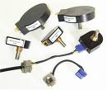
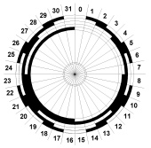

Encoders
Encoders measure linear or angular displacement.
Rotary encoders can be used to measure the rotation of a motor or wheel.
With the help of a microprocessor and software they can be used to determine vehicle velocity and position.
Incremental (or relative) encoders measure changes in position.
Absolute Encoders are self referencing and provide a unique signal for each measurable position within its range.
www.jimsmobile.com/images/encoders.jpg
Incremental
Absolute
http://www.deemencoders.com/Howitworks.html

Slide 36
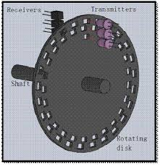
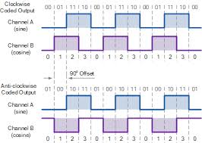
Quadrature Decoding for Incremental Encoders

Slide 37
Obstacle Detection Sensors
Unmanned systems will have to work in unstructured environments. In this type of environment, it is reasonable to expect that objects will most likely lie in the path of the vehicle.
It is the job of obstacle detection sensors to identify obstacles that might impede the motion of the robot.

Slide 38
Obstacle Detection Sensors
Types of obstacle detection sensors:
Laser range finding (LADAR)
Radar
Machine Vision
Ultrasonic
Infrared
Tactile sensor

Slide 39
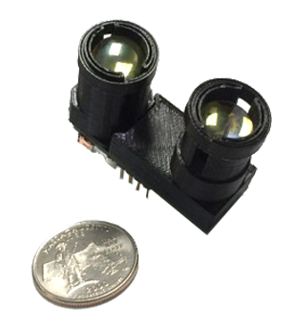
Laser range finder
Uses a laser beam to determine the distance to a reflective object.
Detects the time of flight of a laser pulse sent in a narrow beam towards an object and measures the time taken for the light to be reflected back to the sensor.
Sensor resolution is determined by the brevity of the pulse and the speed of the light detector.
Doppler effect techniques can be used to determine the relative motion and velocity of the target.
Opti-Logic RS100 unit

Slide 40
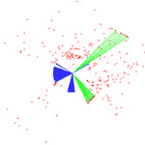
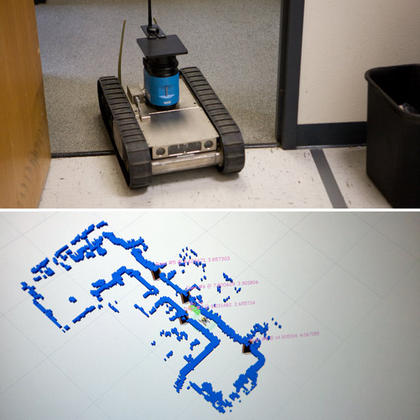
Laser Detection and Ranging (LADAR)
Also know as LIDAR (Light Detection and Ranging)
These systems use the same basic technology as laser range finders with the exception that the laser beam is steered in one or two axes.
LADAR can be used to create two and three dimensional maps of the physical environment.
The system’s laser, scanner & optics, and photodetector & receiver electronics all influence the range, speed, and resolution of the LADAR system.
users.soe.ucsc.edu/~manduchi/Media/Ladar.jpg
www.wired.com/.../2008/01/spawar/10_mapper.jpg

Slide 41
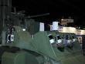
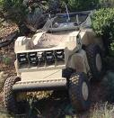
Laser Detection and Ranging (LADAR)
Negative Obstacles create a challenge for all sensing techniques.
Sensors tend to be placed to the front and as high as possible on the vehicle.
The CMU Crusher system uses multiple LADAR sensors to create a dynamic 3-D map of its environment

Slide 42
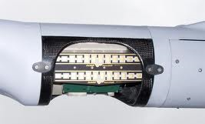
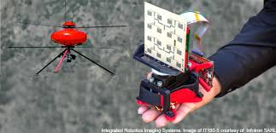
Radar
An object detection system that uses electromagnetic waves to identify the range, altitude, direction of both moving and fixed objects.
The term RADAR was coined in 1941 and stands for radio detection and ranging.
Used primarily in larger UAV and USV systems
http://gcn.com/blogs/emerging-tech/2014/06/uav-radar-sense-and-avoid.aspx
en.wikipedia.org/wiki/Radar

Slide 43
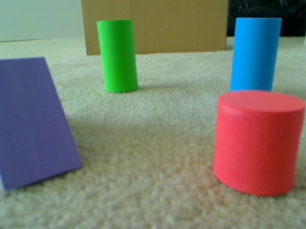
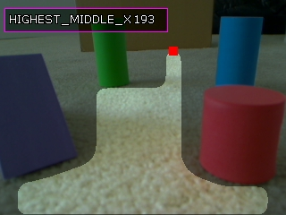
Machine Vision
Machine vision systems process images acquired with cameras in order to produce a representation of objects in the world.
Computer algorithms are used to analyze patterns of pixels values provide by the image sensor.
By identifying and classifying groups of pixels as an obstacle, machine vision can be used to generate information that supports path planning or opportunistic motion behaviors.
www.roborealm.com/.../obstacle_scene_1.jpg

Slide 44
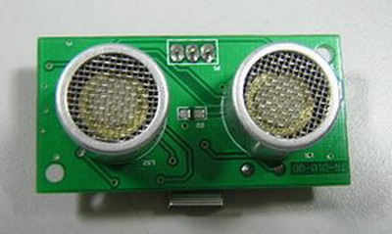
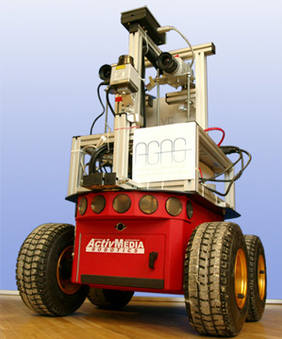
Ultrasonic Sensors
Ultrasonic sensors generate high frequency sound waves and evaluate the echo which is received back by the sensor. Sensors calculate the time interval between sending the signal and receiving the echo to determine the distance to an object.
Relatively inexpensive, simple to implement, good for short distance ranging.
Subject to cross-talk between multiple transmitter / receiver pairs
img.alibaba.com/photo/209455902/TS601dt_ultra...
www.uni-koblenz-landau.de/.../images/robbie6

Slide 45
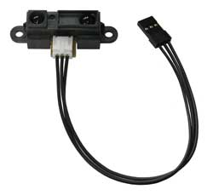
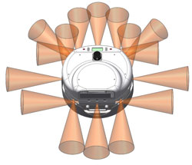
Infrared Sensors
IR rangers use triangulation and a small linear CCD array to compute the distance and/or presence of objects in the field of view.
The basic idea is this: a pulse of IR light is emitted by the emitter. This light travels out in the field of view and either hits an object or just keeps on going.
In the case of no object, the light is never reflected and the reading shows no object. If the light reflects off an object, it returns to the detector and creates a triangle between the point of reflection, the emitter, and the detector.
Low-cost, simple to implement, relatively short range. Work best in controlled lighting. Requires the linearization of the sensor output.
http://www.active-robots.com/products/
robonova/robonova-sensors.shtml
www.wanyrobotics.com/.../infrared-range.jpg
http://www.acroname.com/robotics/info/articles/sharp/sharp.html#e2

Slide 46
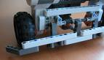

Tactile sensors
Tactile sensors are basically bump sensors. They are mechanical devices that close an electromechanical switch.
The switch closure acts as a binary input to the control system.
Typically used in small low-cost system. Requires low vehicle speeds and mass. Used frequently in biologically inspired behavior-based systems.
http://www.wireless-earth.de/private/mindstorms_eng.html
http://ni.www.techfak.uni-bielefeld.de/robotics

Slide 47
Mission Specific Sensors
Unmanned systems will have a basic job or mission to fulfill.
The nature of this mission will determine what information the unmanned system will have to extract from the environment.
The environmental data that in needed by the UxV will drive the selection of sensors that must be carried by the system and be integrated in to the system’s control application.
The sensor requirements for each mission vary greatly.

Slide 48



Mission Specific Sensors
http://gelardi.com/portfolio/smilee/
http://www.casr.ca/bg-ilds-project.htm
ukintaiwan.fco.gov.uk/.../17685580/robots
Anti-personnel landmine detection

Slide 49
Mission Specific Sensors
Anti-personnel landmine detection
Metal Detectors
Magnetic Signature Duplicators can locate magnetic influence mines with fuses activated by the presence of vehicles or tanks.
Minimum Metal Detectors designed to detect “minimum metal content” mines. This device uses electromagnetic induction to detect very small metal components. Metallic debris in the soil can trigger false alarms.
Forward-Looking Infrared Cameras
detect changes in the thermal properties of the soil. The thermal properties of the soil are directly related to soil density. Mines have a high density in comparison to the disturbed soil around them creating a detectable signature.
Ground-Penetrating Radar
Signals reflect more off of denser material. Mines are denser than the soil around them creating a detectable signature. GPR is dependent on metal content for successful mine detection.
Thermal Neutron Activation (TNA) Detector
Detects unnaturally-high nitrogen levels in the soil which is indicative of the presence of explosives.

Slide 50
Huff’s 2nd Law of Robotics
Sensors lie!
Some times they tell the truth, other times they don’t. (System reliability and robustness, GPS systems on their random walk)
Some times their lies get bigger and bigger. (Unbounded drift in IMU readings)
Some times other objects force them to lie. (the undetected presence of large ferrous objects or electro-magnetic fields around digital compasses)
You have to know how they stretch the truth so you can adjust. (sensor calibration)
You need to be able to predict when a sensor is not telling the truth. (Dempster Shafer Evidence Theory)
You need to get them all in the same room at the same time and see if you can get the straight story. (sensor fusion)

